Slide 1
Case study Scenarios

Slide 2
Scenarios: 1) Generate an unique random number (OTP) 2) Digital Signature 3) Captcha 4) Opt-out

Slide 3
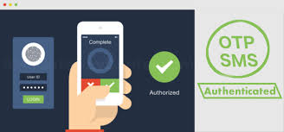
1. Generate a Random number(OTP)
Challenge:
The need for the Secured transactions for the customers either while making a payment or Transfer.
Solution:
It is not supported in CRM but intern can be achieved using the Plugins.
E.g.: When the Button is clicked, the length and the type values of the Password are fetched from the Dropdown List and RadioButtonList.
There are three strings, first containing Upper Case Alphabets, second containing Lower Case Alphabets and the third one containing the 10 digits.
Then a loop is executed and inside the loop a random number is used to fetch the character from the combination of Alphabets and Numeric strings or only the Numeric string based on the type selected in the RadioButtonList.
Inside the For Loop, a While loop is used to avoid repetition of the characters.
The generated unique random OTP i.e. One Time Password is displayed in the Label control.

Slide 4
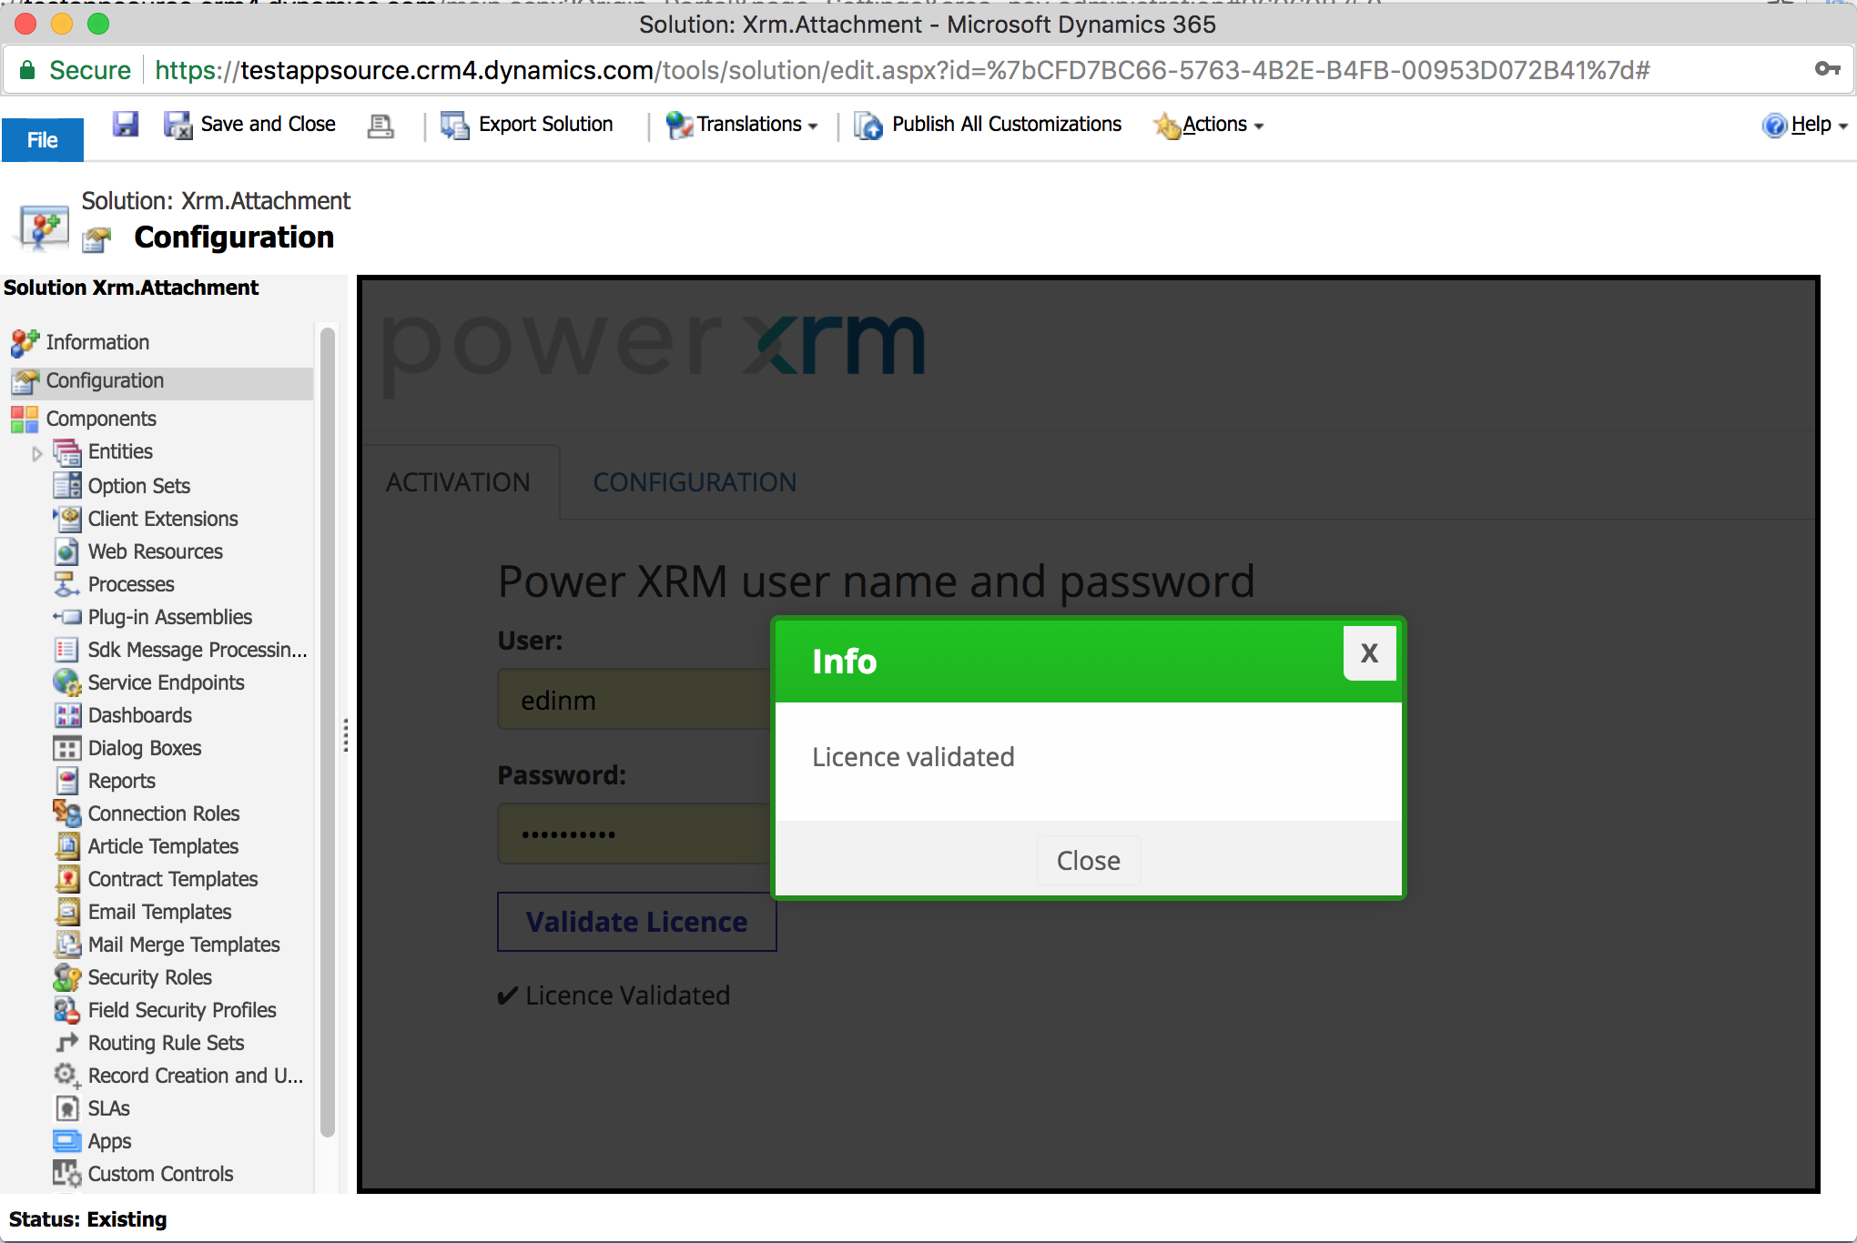

Slide 5

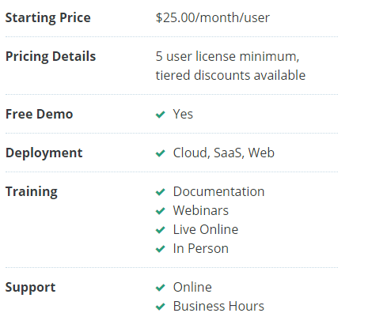
2. Digital Signature

Slide 6
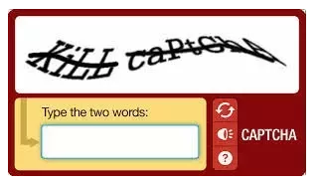
3. Captcha
Captcha is mainly used as a security check to ensure only human users can pass through. Generally, computers or bots are not capable of solving a captcha and hence to verify that no robotic activities take place.

Slide 7

4. Opt-Out
If the customer after few days don’t want to continue with further procedures as in Signing the document and Making the payment. In such scenario providing him an additional feature to opt-out or cancel.

Slide 8
THANK YOU

